Slide 1

“relationship between my BiTaksi usage and my academic schedule”
Fikret Dara Aktas-32511

Slide 2


Data:
Sabancı University academic schedule
BiTaksi usage

Slide 3
HYPOTESIS
“There is a significant relationship between BiTaksi usage and academic schedule factors such as lecture times, workload.”

Slide 4
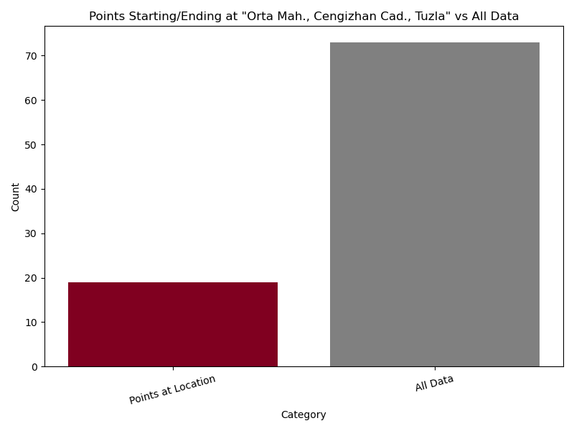
First I want to start with visualization of my transportation to school
Based on the initial graph, it appears that my visits to the university are less frequent than anticipated. To gain further clarity and validate this observation, I decided to explore the data through an alternative visualization.

Slide 5
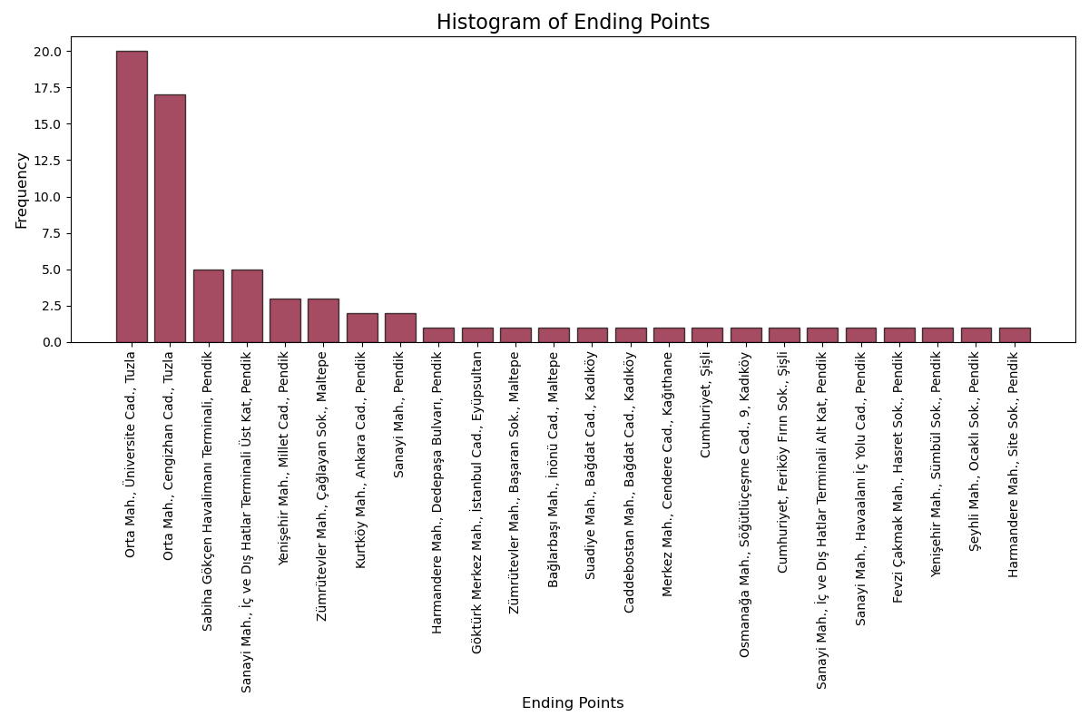
Then, I sought to compare my trips to the university against other destinations separately to better understand the distribution and identify potential patterns.
Given the numerous destinations, I opted to use a histogram to visualize the differences more clearly and effectively highlight the distribution across locations.
This histogram clearly illustrates that the majority of my regular trips are to the university,

Slide 6
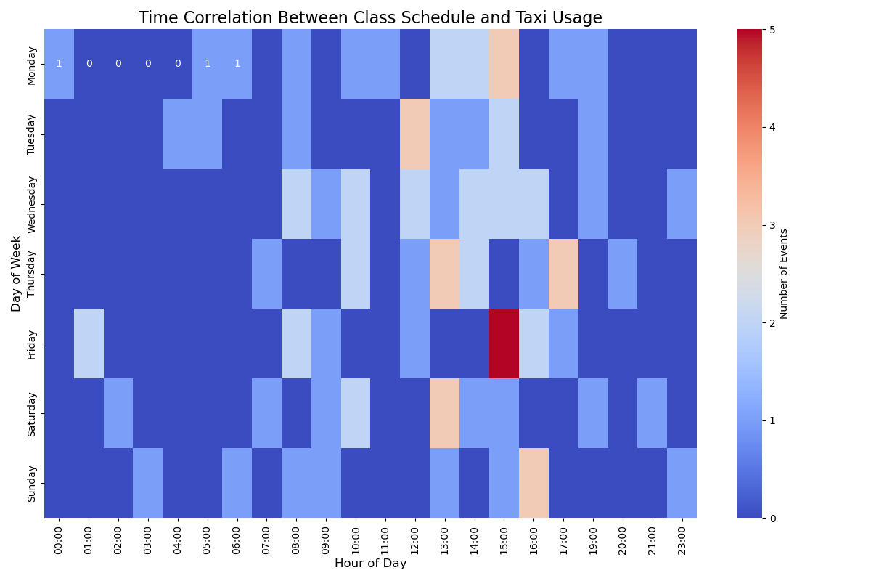
After confirming the patterns, I proceeded to examine the correlation between my academic schedule and BiTaksi usage to uncover potential relationships.
Initially, I thought using a heatmap would be a logical choice to analyze the data. However, after creating the graph, I realized that it was overly complex and potentially misleading for interpretation.

Slide 7
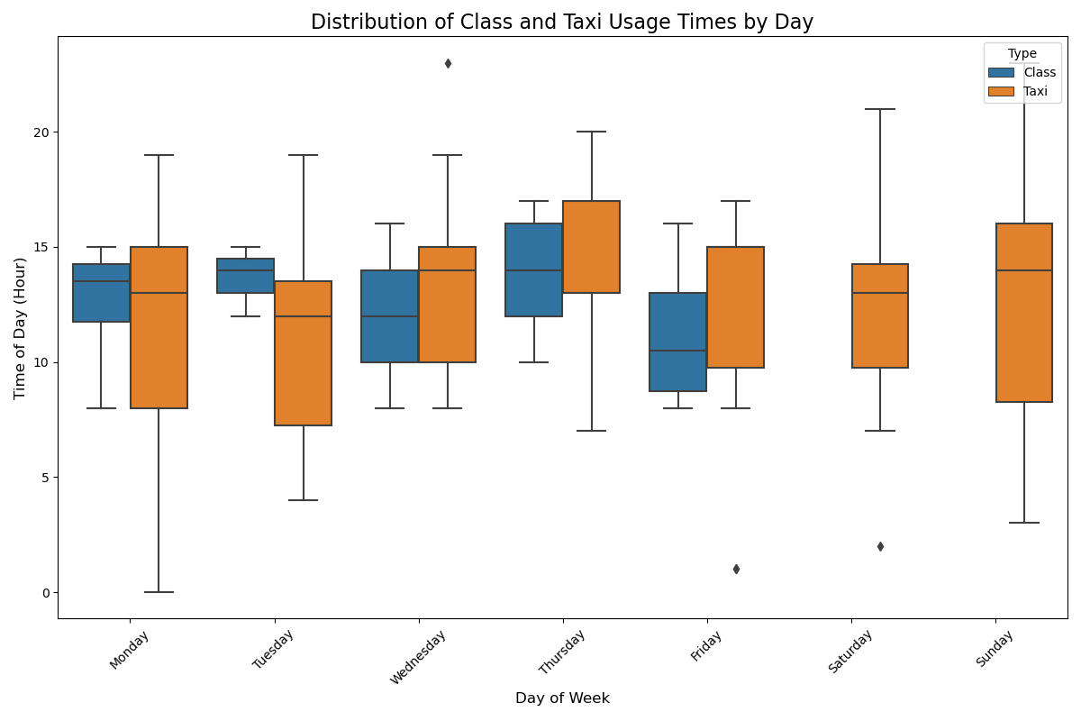
After further research, I concluded that a boxplot would be a more suitable choice for visualizing the correlation in this case, as it provides a clearer representation of the data distribution.
The boxplot confirms a strong relationship between BiTaksi usage and academic schedules. Peak taxi usage aligns with class times, indicating that academic obligations significantly influence transportation patterns.

Slide 8
Results:
• Frequent School Trips: Most trips are to the university, confirming its role as the primary destination and supporting the hypothesis.
• Support for Hypothesis: The findings strongly align with the hypothesis that BiTaksi usage correlates with academic schedules, particularly lecture times and workload.
• Effective Visualization: While the heatmap was complex, the boxplot clearly showed that taxi usage peaks align with class schedules.

Slide 9
Possible improvements:
• Since data is on my usage of bitaxi, the analysis can be updated with newer data over a more extended period to observe changes..
• Other Transportations: I used only bitaxi data but in real life I use other transportations like tiktak, car, bus i can add them to the dataset..
• Exam Periods: I can add my final periods and use that data for more diversity since final period can be verry different than normal times.

Slide 10
THANK YOU FOR YOUR TIME!

